Slide 1
Spring

Slide 2
What is Spring?
Spring Modules
What is Spring Bean?
Dependency Injection (DI)
Spring Projects
SpringBoot
Spring MVC

Slide 3
What is Spring?

Slide 4
What is Spring?
is a framework for building Java applications
handles Dependency Injection (DI)
wraps excellent Java libraries – for examples, Task Executors and Quartz Scheduler
provides a lot of implementations like REST, MVC web framework, security, etc.

Slide 5
Spring Features - 1
Lightweight - the core of spring framework is around 1MB. And the processing overhead is also very negligible.
Inversion of control (IOC) - loose coupling: the objects give their dependencies instead of creating or looking for dependent objects.
Aspect oriented (AOP) - supports Aspect oriented programming
Container - contains and manages the life cycle and configuration of application objects.
Notes:
IOC(Inversion Of Control): Giving control to the container to create and inject instances of objects that your application depend upon, means instead of you are creating an object using the new operator, let the container do that for you.
Spring AOP (Aspect-oriented programming) framework is used to modularize cross-cutting concerns in aspects.
It’s just an interceptor to intercept some processes
https://www.mkyong.com/spring/spring-aop-examples-advice/

Slide 6
Spring Features - 2
MVC Framework - comes with MVC framework, and accommodates view technologies like JSP, Velocity, POI, etc.
Transaction Management - provides a generic abstraction layer for transaction management.
JDBC Exception Handling - offers a meaningful exception hierarchy, which simplifies the error handling strategy.
Integration with Hibernate, JDO, and iBATIS - provides integration services with Hibernate, JDO and iBATIS
Notes:
JDBC Exception Handling - All the JDBC execute statement or connection related exception throws SQLException and its a checked exception so we must either catch it or throw it.
JPA (Hibernate), JDO (DataNuclus), iBATIS
ORM helps you to manage database records create, read, update, delete via object

Slide 7
Spring Modules

Slide 8
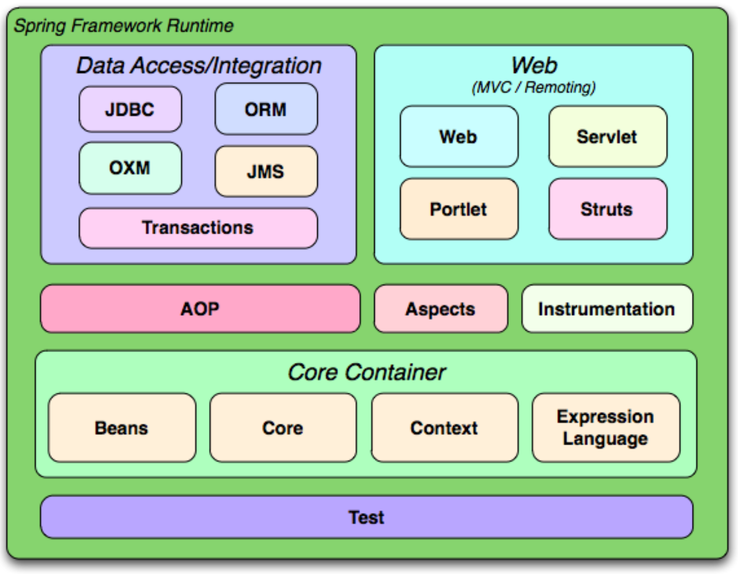
Spring Modules
Notes:
OXM: Object/XML mapping: a marshaller serializes an object to XML, and an unmarshaller deserializes XML stream to an object

Slide 9
Core Container
The Core Container consists of the Core, Beans, Context, and Expression Language modules.
The Core and Beans modules provide the IoC and Dependency Injection features.
The Context module inherits its features from the Beans module and adds support for internationalization, event-propagation, resource-loading, and the transparent creation of contexts. It also supports Java EE features such as EJB, JMX ,and basic remoting.
The Expression Language module provides a powerful expression language for querying and manipulating an object graph at runtime.
Notes:
2 mins
IoC Containers control and manage the life cycle of some objects: creation, destruction and callback invocations.
having DI is the opposite to having hardcoded dependencies
http://blog.bytecode.tech/inversion-of-control-vs-dependency-injection/
Java Management Extensions (JMX) is a Java technology that supplies tools for managing and monitoring applications, system objects, devices (such as printers) and service-oriented networks
EJB is a server-side software component that encapsulates business logic of an application
The Expression Language module supports setting and getting of property values, property assignment, method invocation, accessing the context of arrays, collections and indexers, logical and arithmetic operators, named variables, and retrieval of objects by name from Spring's IoC container.

Slide 10
Data Access/Integration
The JDBC module provides a JDBC-abstraction layer that removes the need to do tedious JDBC coding and parsing of database-vendor specific error codes.
The ORM module provides integration layers for popular object-relational mapping APIs, including JPA, JDO, Hibernate, and iBatis.
The OXM module provides an abstraction layer that supports Object/XML mapping implementations for JAXB, Castor, XMLBeans, JiBX and XStream.
The Java Messaging Service (JMS) module contains features for producing and consuming messages.
The Transaction module supports programmatic and declarative transaction.
Notes:
JMS API is specific for Java Platform only, but AMQP (Advanced Message Queuing Protocol) supports many technologies.
1. Programmatic Transaction Management: Transaction is managed with the help of programming and provides extreme flexibility, but it is difficult to maintain.
2. Declarative Transaction Management: Transaction management is separated from business code and only annotations or XML based configurations are used to manage the transactions.

Slide 11
Web
Spring's Web module provides basic web-oriented integration features such as multipart file-upload functionality and the initialization of the IoC container using servlet listeners and a web-oriented application context. It also contains the web-related parts of Spring's remoting support.
The Web-Servlet module contains Spring's model-view-controller (MVC) implementation for web applications.
The Web-Struts module contains the support classes for integrating a classic Struts web tier within a Spring application. Note that this support is now deprecated as of Spring 3.0.
The Web-Portlet module provides the MVC implementation to be used in a portlet environment.
Notes:
Spring MVC is loosely coupled framework whereas Struts is tightly coupled (no out-of-box support for dependency injection)
Servlets and Portlets are web based components which use Java for their implementation.

Slide 12
What is Spring Bean?

Slide 13

What is Spring Bean?
In Spring, Bean is nothing special, any object in the Spring framework that we initialize through Spring container is called Spring Bean.
Any normal Java POJO class can be a Spring Bean if it’s configured to be initialized via container by providing configuration metadata information.
Configuration metadata:
How to create a bean
Bean's lifecycle details
Bean's dependencies

Slide 14
Bean Scopes
Scope | Description
singleton | a single instance per Spring IoC container (default)
prototype | a single bean definition to have any number of object instances
request | a bean definition to an HTTP request (only valid in the context of a web-aware Spring ApplicationContext)
session | a bean definition to an HTTP session (only valid in the context of a web-aware Spring ApplicationContext)
global-session | a bean definition to a global HTTP session (only valid in the context of a web-aware Spring ApplicationContext)
Notes:
2 mins
request: the Spring container will create a brand new instance of the bean using the bean definition for each and every HTTP request
Session: bean will be effectively scoped at the HTTP Session level
global-session: Beans defined at the global session scope are scoped (or bound) to the lifetime of the global portlet Session.

Slide 15
Custom init() and destroy() methods
Bean local definition - applicable to a single bean
<beans>
<bean id="demoBean" class="com.manulife.DemoBean"
init-method="customInit"
destroy-method="customDestroy"></bean>
</beans>
Global definition - will be invoked for all bean definitions given under <beans> tag.
<beans default-init-method="customInit" default-destroy-method="customDestroy">
<bean id="demoBean" class="com.howtodoinjava.task.DemoBean"></bean>
</beans>

Slide 16
@PostConstruct and @PreDestroy annotations
Spring 2.5 onwards, you can use annotations also for specifying life cycle methods using @PostConstruct and @PreDestroy annotations.
@PostConstruct - will be invoked after the bean has been constructed using default constructor and just before it’s instance is returned to requesting object.
@PreDestroy - is called just before the bean is about be destroyed inside bean container.

Slide 17
Dependency Injection (DI)

Slide 18
Inversion of Control (IoC)
Inversion of Control is a principle in software engineering by which the control of objects or portions of a program is transferred to a container or framework.
Advantages :
decoupling the execution of a task from its implementation
making it easier to switch between different implementations
greater modularity of a program
greater ease in testing

Slide 19
Dependency Injection (DI)
Dependency injection is a pattern through which to implement IoC, where the control being inverted is the setting of object’s dependencies.
The act of connecting objects with other objects, or “injecting” objects into other objects, is done by an assembler (i.e. Spring IoC container) rather than by the objects themselves.

Slide 20
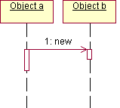
Without DI – Traditional way
public class A {
private B b;
public A() {
b=new B();
}
}
design decisions:
Class A needs a reference to Class B.
Class B is a concrete class that has a default constructor.
Class A owns the instance of class B.
No other class can access the instance of Class B.

Slide 21
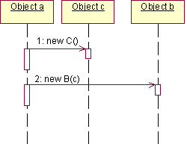
Without DI - Requirement Changes
If any one of the above design decisions change, then the code must be modified. For example, if Class B changed to have a non-default constructor, which takes Class C, then the above listing would change to the following.
public class A {
private B b;
public A() {
C c=new C();
b=new B(c);
}
}
Notes:
the above listing assumes certain design decisions. Now Object "a" owns both Object "b" and Object "c". If Class B or Class C changes at all, then Class A needs to change as well.

Slide 22
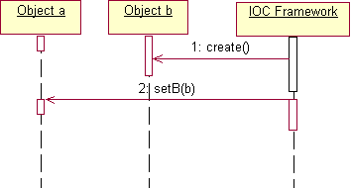
DI Solution
The responsibility of creating Object "b" moves from Object "a" to the IoC framework, which creates and injects Object "b" into Object "a". This insulates Class A from the changes in Class B.
public class A {
private B b;
public A() { }
public setB(B b) {
this.b=b;
}
}
Notes:
design decisions:
A needs a reference to B, and it doesn't need to know how B is instantiated.
B can be an interface, an abstract class, or a concrete class.
Before the instance of Class A is used, it needs a reference to the instance of Class B.

Slide 23
DI - Constructor-Based
The container will invoke a constructor with arguments each representing a dependency we want to set.
Example
@Configuration
public class AppConfig {
@Bean
public Store store() {
return new Store(item1());
}
}
indicates that the class is a source of bean definitions
to define a bean

Slide 24
DI - Setter-Based
The container will call setter methods of our class, after invoking a no-argument constructor or no-argument static factory method to instantiate the bean.
Example
@Bean
public Store store() {
Store store = new Store();
store.setItem(item1());
return store;
}
XML configuration:
<bean id="store" class=“com.manulife.Store">
<property name="item" ref="item1" />
</bean>

Slide 25
DI - Field-Based (Autowired)
In case of Field-Based DI, we can inject the dependencies by marking them with an @Autowired annotation:
public class Store {
@Autowired
private Item item;
}
While constructing the Store object, if there’s no constructor or setter method to inject the Item bean, the container will use reflection to inject Item into Store.
Notes:
Reflection is a language's ability to inspect and dynamically call classes, methods, attributes, etc. at runtime.

Slide 26
Important Annotations
Spring uses DI to configure and to bring your application together.
It means that you just declare the components of your system and how they interact.
Then Spring wires it all together at runtime.
Here are the most important annotations you should know of:
@Configuration, @Bean, @ComponentScan, @Component, @Service, @Repository, @Autowired, @Qualifier, etc.
Notes:
Starting from Spring 2.5 it became possible to configure the DI using annotations.
@Component: generic stereotype for any Spring-managed component
@Repository: stereotype for persistence layer
@Service: stereotype for service layer
@Controller: stereotype for presentation layer (spring-mvc)

Slide 27
Annotation Based Configuration
Before we can use annotation-based wiring, we will need to enable it in our Spring configuration file.
<?xml version = "1.0" encoding = "UTF-8"?>
<beans xmlns = "http://www.springframework.org/schema/beans"
xmlns:xsi = "http://www.w3.org/2001/XMLSchema-instance"
xmlns:context = "http://www.springframework.org/schema/context"
xsi:schemaLocation = "http://www.springframework.org/schema/beans
http://www.springframework.org/schema/beans/spring-beans-3.0.xsd
http://www.springframework.org/schema/context
http://www.springframework.org/schema/context/spring-context-3.0.xsd">
<context:annotation-config/>
</beans>
Add this before using annotation in your code

Slide 28
Configuration, @Bean and @ComponentScan
@Configuration
to mark a class as a source of the bean definitions. Beans are the components of the system that you want to wire together.
@Bean
a bean producer. Spring will handle the life cycle of the beans for you, and it will use these methods to create the beans.
@ComponentScan
to make Spring scan the packages configured with it for the @Configuration classes.
Notes:
The @ComponentScan annotation is used to tell Spring the packages to scan for annotated components.

Slide 29
@Autowired and @Qualifier
@Autowired
for automatic injection of beans. Spring @Qualifier annotation is used in conjunction with @Autowired to avoid confusion when we have two of more bean configured for same type.
@Qualifier
when you need more control of the DI process, this is used to avoid the confusion that occurs when you create more than one bean of the same type and want to wire only one of them with a property.

Slide 30
Example to inject a specific bean
@Component
public class Doctor1 implements DoctorInterface {
//
}
@Component
public class Doctor2 implements DoctorInterface {
//
}
@Component
public class Clinic {
@Autowired
@Qualifier(“doctor2")
private DoctorInterface dependency;
...
}
Two comoponents implement the same interface
Spring will now know which bean to autowire when @Qualifier is used

Slide 31
Spring Projects

Slide 32
Spring Projects
Spring Projects
Spring Boot
Spring Security
And more …
Spring AMQP
Spring Data
Spring Cloud
Notes:
There are a lot of sub projects: Spring Boot, Spring Framework, Spring Cloud, Spring Data, Spring Batch, Spring Security, Spring AMQP, Spring Web Services, etc.
We will introduce some of the Spring projects in this section, they are widely used in Manulife’s projects.

Slide 33

Spring Boot
Spring Boot provides a pre-configured set of frameworks to reduce boilerplate configuration so that you can have a Spring application up and running with the smallest amount of code.

Slide 34
Spring Boot in a minute
Spring Boot
Spring Framework
Embedded server
(Tomcat, Jetty, …)
XML bean configuration
Spring Boot
@SpringBootApplication
Traditional Spring
@Configuration
@EnableAutoConfiguration
@ComponentScan
Notes:
@Configuration: allow to register extra beans in the context or import additional configuration classes
@EnableAutoConfiguration: enable Spring Boot’s auto-configuration mechanism
@ComponentScan: enable @Component scan on the package where the application is located (see the best practices)

Slide 35
Features
Auto-Configuration - No need to manually configure dispatcher servlet, static resource mappings, property source loader, message converters etc.
Dependency Management - The different versions of commonly used libraries are pre-selected and grouped in different starter POMs that we can include in your project.
Advanced Externalized Configuration - There is a large list of bean properties that can be configured through application.properties file without touching java or xml config.
Production support - We get health checking, application and jvm metrics, jmx via http and a few more things for free.
Runnable Jars - We can package your application as a runnable jar
Notes:
Auto-configuration: Provides basic configuration needed to configure the application by looking at
1) frameworks in classpath 2) configuration of the application
Dependency Management: Spring Boot helps to manage libraries dependency
Advanced Externalized Configuration: make configuration easily
Production support: provide production-ready features e.g. health checks and externalized configuration
Runnable: embed Tomcat, Jetty, etc. directly (no need to deploy WAR files)

Slide 36

Spring MVC framework
The Spring Web model-view-controller (MVC) framework is designed around a DispatcherServlet that dispatches requests to handlers, with configurable handler mappings, view resolution, locale and theme resolution as well as support for uploading files.
Notes:
With the introduction of Spring 3.0, the @Controller mechanism also allows you to create RESTful Web sites and applications, through the @PathVariable annotation and other features.

Slide 37
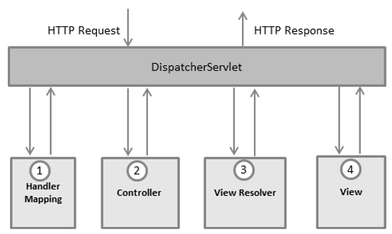
MVC Flow
https://www.tutorialspoint.com/spring/spring_web_mvc_framework.htm
Notes:
The Spring MVC framework is designed around a DispatcherServlet that handles all the HTTP requests and responses.
After receiving an HTTP request, DispatcherServlet consults the HandlerMapping to call the appropriate Controller.
The Controller takes the request and calls the appropriate service methods based on used GET or POST method. The service method will set model data based on defined business logic and returns view name to the DispatcherServlet.
The DispatcherServlet will take help from ViewResolver to pickup the defined view for the request.
Once view is finalized, The DispatcherServlet passes the model data to the view which is finally rendered on the browser.

Slide 38
Required Configuration – web.xml
You need to map requests that you want the DispatcherServlet to handle, by using a URL mapping in the web.xml file.
<web-app>
<display-name>Spring MVC Application</display-name>
<servlet>
<servlet-name>HelloWeb</servlet-name>
<servlet-class>org.springframework.web.servlet.DispatcherServlet</servlet-class>
<load-on-startup>1</load-on-startup>
</servlet>
<servlet-mapping>
<servlet-name>HelloWeb</servlet-name>
<url-pattern>*.jsp</url-pattern>
</servlet-mapping>
</web-app>

Slide 39
Required Configuration
The web.xml file will be kept in the WebContent/WEB-INF directory of your web application.
Upon initialization of HelloWeb DispatcherServlet, the framework will try to load the application context from a file named [servlet-name]-servlet.xml located in the application's WebContent/WEB-INF directory. In this case, our file will be HelloWeb-servlet.xml.

Slide 40
Required Configuration – HelloWeb-servlet.xml
Let us check the required configuration for HelloWeb-servlet.xml file, placed in your web application's WebContent/WEB-INF directory
<beans>
<context:component-scan base-package = "com.manulife" />
<bean class = "org.springframework.web.servlet.view.InternalResourceViewResolver">
<property name = "prefix" value = "/WEB-INF/jsp/" />
<property name = "suffix" value = ".jsp" />
</bean>
</beans>
Notes:
The [servlet-name]-servlet.xml file will be used to create the beans defined.
The <context:component-scan...> tag will be use to activate Spring MVC annotation scanning capability which allows to make use of annotations like @Controller and @RequestMapping etc.
The InternalResourceViewResolver will have rules defined to resolve the view names. As per the above defined rule, a logical view named hello is delegated to a view implementation located at /WEB-INF/jsp/hello.jsp.

Slide 41
Controller
The @Controller annotation indicates that the class serves the role of a controller.
The @RequestMapping annotation is used to map a URL to either an entire class or a particular handler method.
@Controller
public class HelloController {
@RequestMapping(value = "/hello", method = RequestMethod.GET)
public String printHello(ModelMap model) {
model.addAttribute("message", "Hello Spring MVC Framework!");
return "hello";
}
}
Notes:
The value attribute indicates the URL to which the handler method is mapped and the method attribute defines the service method to handle HTTP GET request.

Slide 42
Exercise
Spring MVC

Slide 43
Spring – Exercise 1
Key steps (refer Generali-2b-Spring-exercises.docx Exercise 1 for details)
Generate a Spring Boot project structure using Spring Initializr
Understand the structure
Understand the dependencies in pom.xml
Create the controller and define the endpoints
Create the views (JSPs)
Startup and shut down the server
Examine the pages
Bonus
Inject bean in controller
Read value from property file

Slide 44

Spring Cloud
Spring Cloud builds on Spring Boot by providing a bunch of libraries that enhance the behaviour of an application.
You can take advantage of the basic default behaviour to get started really quickly, and then when you need to, you can configure or extend to create a custom solution.

Slide 45
Spring Cloud - Features
Distributed/versioned configuration
Service registration and discovery
Routing
Service-to-service calls
Load balancing
Circuit Breakers
Global locks
Leadership election and cluster state
Distributed messaging

Slide 46

Spring Security
A framework that focuses on providing both authentication and authorization to Java applications.
Like all Spring projects, the real power of Spring Security is found in how easily it can be extended to meet custom requirements.
Notes:
Spring Security is a separate module of the Spring framework that focuses on providing authentication and authorization methods in Java applications.
It also takes care of most of the common security vulnerabilities such as CSRF attacks.

Slide 47
Spring Security - Features
Proven technology, it’s better to use this than reinvent the wheel.
Prevents some of the common attacks such as CSRF, session fixation attacks.
Easy to integrate in any web application. We don’t need to modify web application configurations, spring automatically injects security filters to the web application.
Provides support for authentication by different ways – in-memory, DAO, JDBC, LDAP and many more.
Provides option to ignore specific URL patterns, good for serving static HTML, image files.
Support for groups and roles.

Slide 48

Spring Data
It makes it easy to use data access technologies, relational and non-relational databases, map-reduce frameworks, and cloud-based data services.
Notes:
Including:
Spring Data Commons - Core Spring concepts underpinning every Spring Data project.
Spring Data JPA - Makes it easy to implement JPA-based repositories.
Spring Data JDBC - JDBC-based repositories.
Spring Data LDAP - Provides Spring Data repository support for Spring LDAP.
Spring Data MongoDB - Spring based, object-document support and repositories for MongoDB.
Spring Data REST - Exports Spring Data repositories as hypermedia-driven RESTful resources.
Spring Data KeyValue - Map-based repositories and SPIs to easily build a Spring Data module for key-value stores.
Spring Data Redis - Provides easy configuration and access to Redis from Spring applications.
etc.

Slide 49
Spring Data - Features
Powerful repository and custom object-mapping abstractions
Dynamic query derivation from repository method names
Implementation domain base classes providing basic properties
Possibility to integrate custom repository code
Easy Spring integration
Advanced integration with Spring MVC controllers
Experimental support for cross-store persistence

Slide 50

Spring AMQP (Advanced Message Queuing Protocol)
Messaging is a technique for inter-application communication.
Producer and consumer of messages are decoupled by an intermediate messaging layer known as the message broker.
Message broker provides features like persistent storage of messages, message filtering, message transformation, etc.
Notes:
relies on asynchronous message-passing instead of synchronous request response-based architecture

Slide 51



Why we need AMQP?
The main drawback or limitation of JMS API is interoperability that means we can develop messaging systems that will work only in Java based applications. It does not support other languages.
The major advantage of AMQP is that it supports interoperability between heterogeneous platforms and messaging brokers. We can develop our Messaging systems in any language (Java, C++, C#, Ruby etc.) and in any operating system

Slide 52
Exercise
Spring Data

Slide 53
Spring – Exercise 2
Key steps (refer Generali-2b-Spring-exercises.docx Exercise 1 for details)
Base on Exercise 1, develop a service to access database
Understand the dependencies in pom.xml
Create the model for persistence
Create the repository to access database
Create the service for controller
Modify the views to display the results from database
Bonus
Connect to an external database server

Slide 54
Summary
What is covered
What is Spring?
Spring Modules
What is Spring Bean?
Dependency Injection (DI)
Spring Projects

